Slide 1
NetGuard: A Real-Time Network Attack Detection & Isolation Simulator
INFO 6205 Final Project
Team Members:
- Madhumitha Nandhikatti
- Priyanka Bhadrappanavar
- Srivardhan Karanam

Slide 2
Problem Description
The Problem
Modern computer networks face constant threats from malicious packets, botnets, and worm-like propagations.
Even small infections can spread rapidly if not isolated in time.
Goal of the Project
Build an interactive real-time network defense simulator that:
Visualizes network nodes and packet flow
Detects malicious packet propagation
Identifies infected nodes
Automatically isolates compromised nodes
Demonstrates how threats spread vs. how defenses respond
Why this matters
This simulation helps students understand:
Graph-based network topology
Infection spread dynamics
Impact of node isolation
Defense strategies in real time

Slide 3
Analysis (Initial Study & Research)
We studied the following topics:
Graph Theory:
Networks modeled as undirected graphs
Packet movement via shortest paths
Adjacency list representation
Computer Networking:
Packet propagation
Malicious packet behavior
Node compromise and isolation
Cybersecurity Concepts:
Infection spread
Quarantine/isolation strategies
Real-time threat visualization
Algorithmic Approaches:
Dijkstra's algorithm for shortest paths
MinHeap for priority queue in Dijkstra's
LinkedQueue for packet scheduling
Graph traversal for routing
Timer-based event simulation

Slide 4
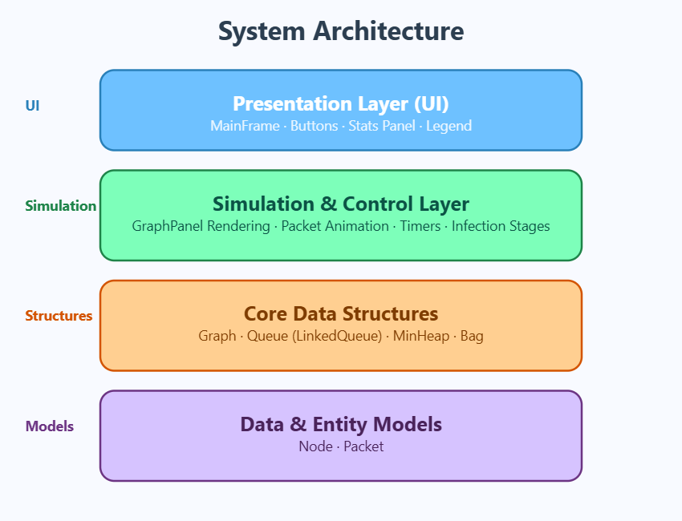
Design Overview

Slide 5
Key Design Principles
Separation of GUI and logic
Real-time simulation loop with Timer
Scalable graph structure
Encapsulated node/packet behavior
Easy to extend

Slide 6
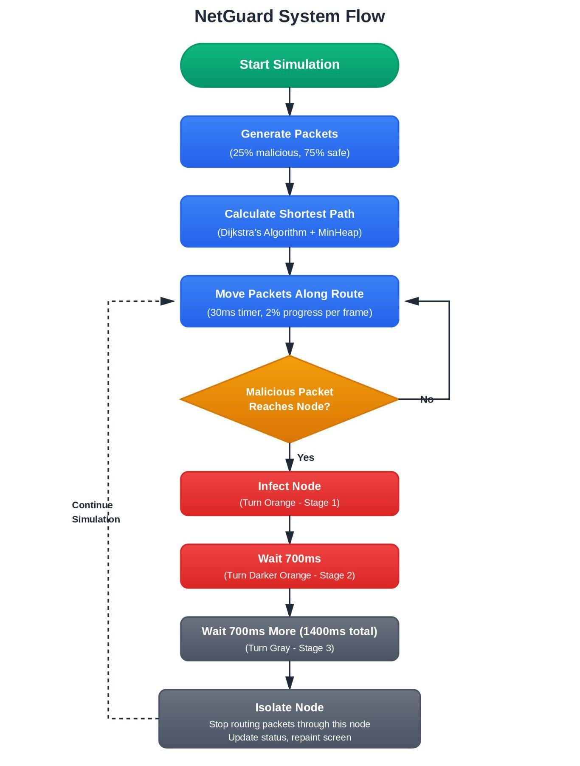
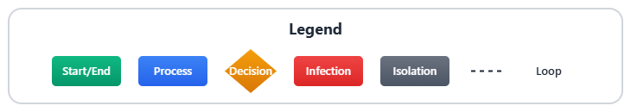
Flowchart (System Logic)

Slide 7
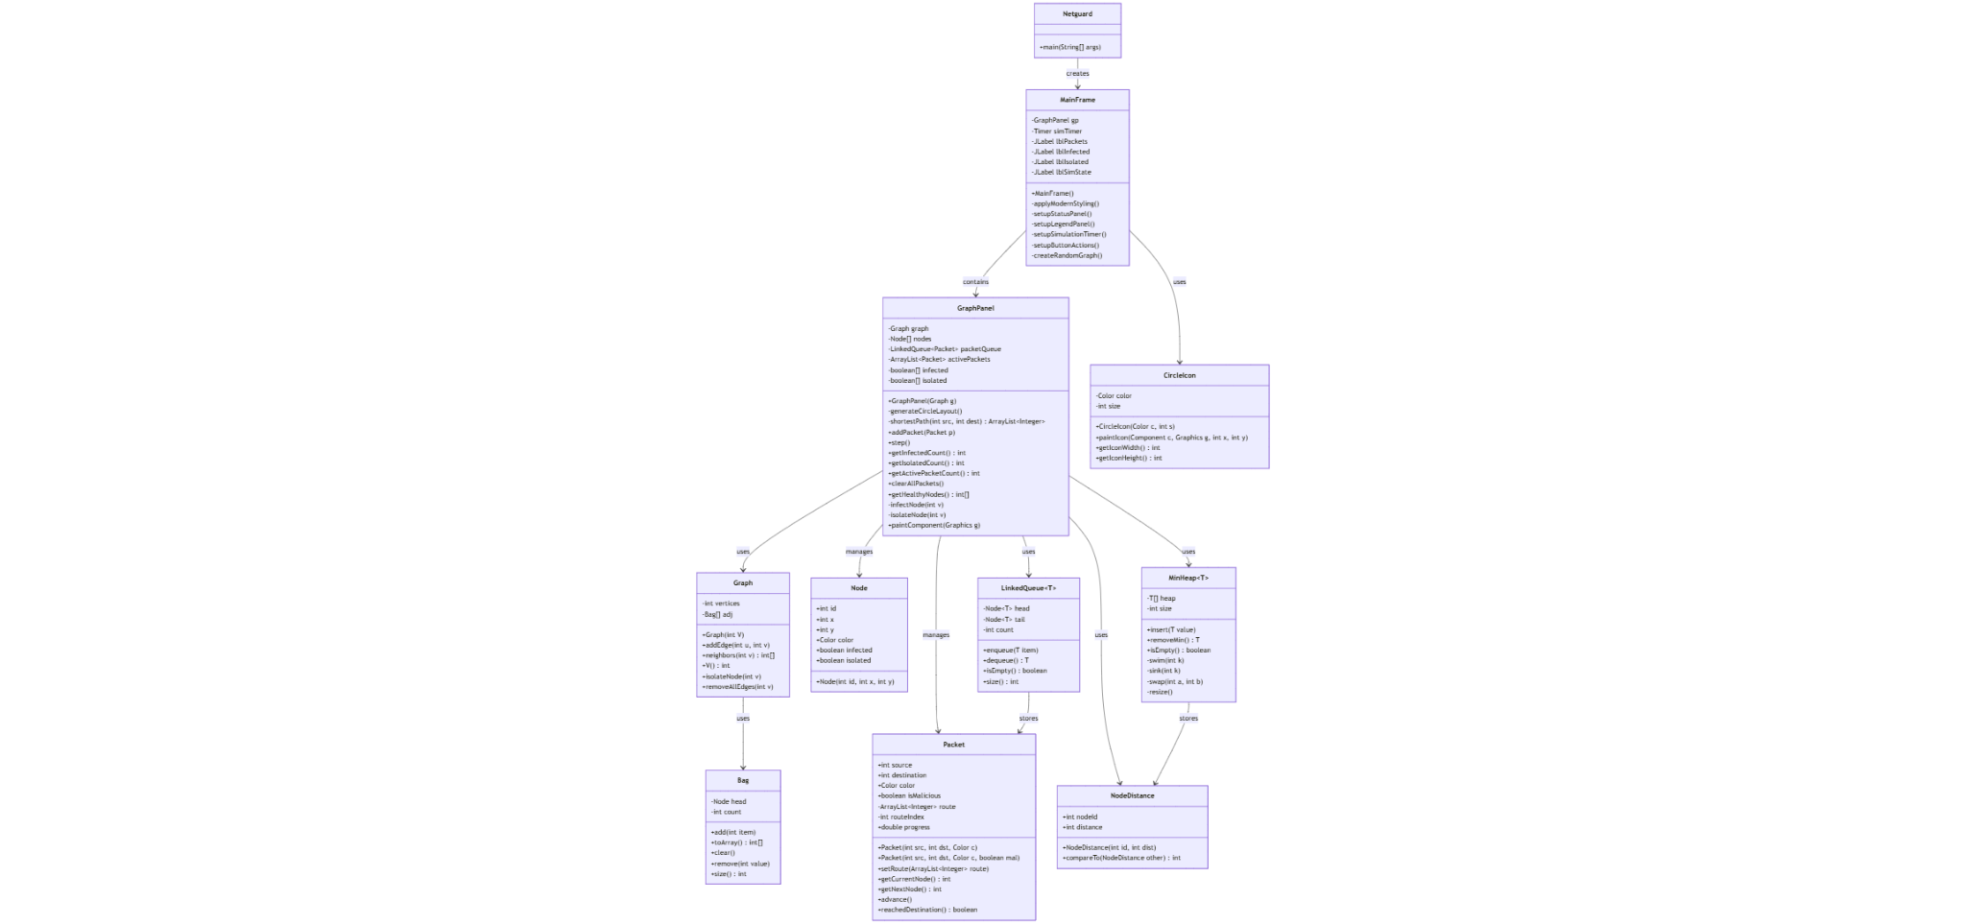
UML
Live Mermaid Link

Slide 8
Algorithms
Shortest Path Algorithm
Dijkstra's algorithm with MinHeap priority queue
Complexity: O((V + E) log V)
Avoids isolated nodes during pathfinding
Maintains parent pointers for route reconstruction
Dynamic rerouting when nodes are quarantined
Infection Cascade Algorithm
3-stage time-based progression:
1. Immediate: Orange color (infected)
2. 700ms: Darker orange (infection spreading)
3. 1400ms: Gray (isolated/quarantined)
● Implemented using nested javax.swing.Timer
● Prevents reinfection of already infected nodes
Node Isolation Algorithm
Removes node from active routing
Packets reroute around isolated nodes
Updates tracking arrays (infected[], isolated[])
Prevents further infection spread
Animation Loop
Swing Timer fires every 30ms (~33 FPS)
Linear interpolation for smooth packet movement
Real-time status updates (packets, infected, isolated)
Canvas repainted each frame

Slide 9
Implementation (Tools & APIs)
Development Tools
Java 21
NetBeans IDE 22
Java Swing for GUI
Graphics2D API for custom rendering
javax.swing.Timer for animation
Custom Data Structures
Graph → Adjacency list for network topology
MinHeap → Priority queue for Dijkstra's (Ch. 27)
Bag → Linked list for neighbor storage (Ch. 1-3)
LinkedQueue → FIFO packet scheduling (Ch. 7-8)
NodeDistance → Wrapper for MinHeap integration
Key Classes
● MainFrame → GUI container and event handling
● GraphPanel → Visualization and simulation logic
● Node → Visual node representation
● Packet → Data transfer with routing information
Architecture Pattern
● Separation of concerns (GUI vs. Logic)
● Event-driven architecture (Swing Timer)
● MVC-inspired: Model (Graph, Node, Packet),
View (GraphPanel, MainFrame), Controller (Timer, Handlers)

Slide 10
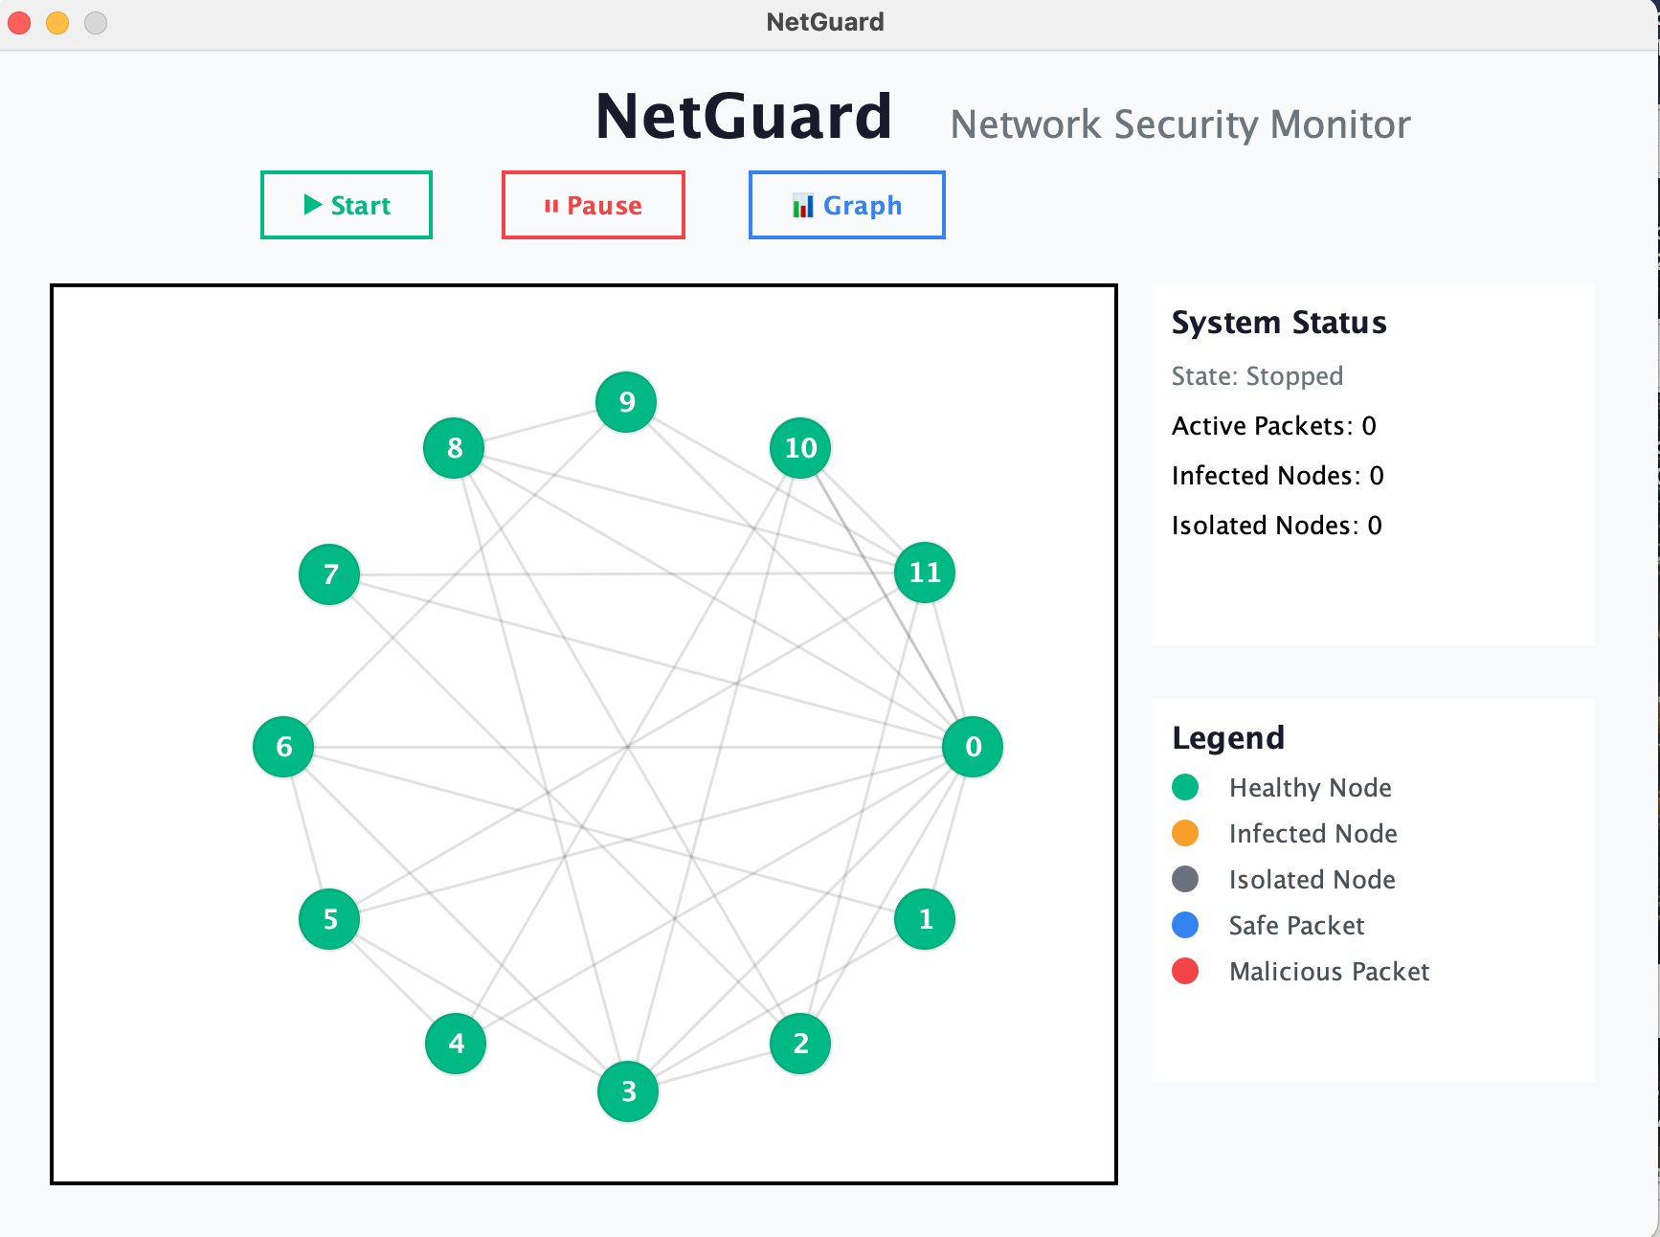
Results
(Screenshots)

Slide 11
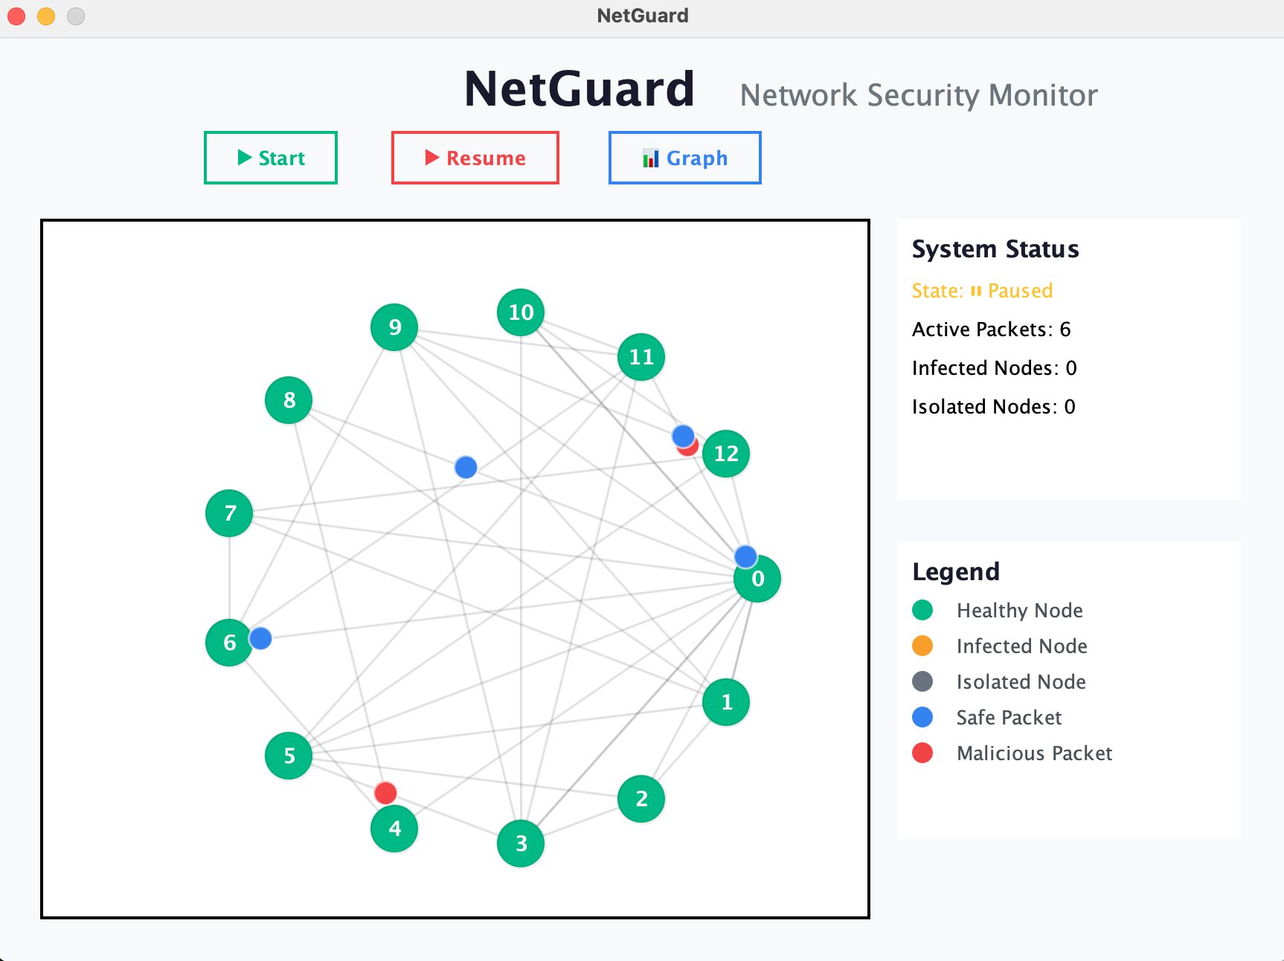
Results
(Screenshots)

Slide 12
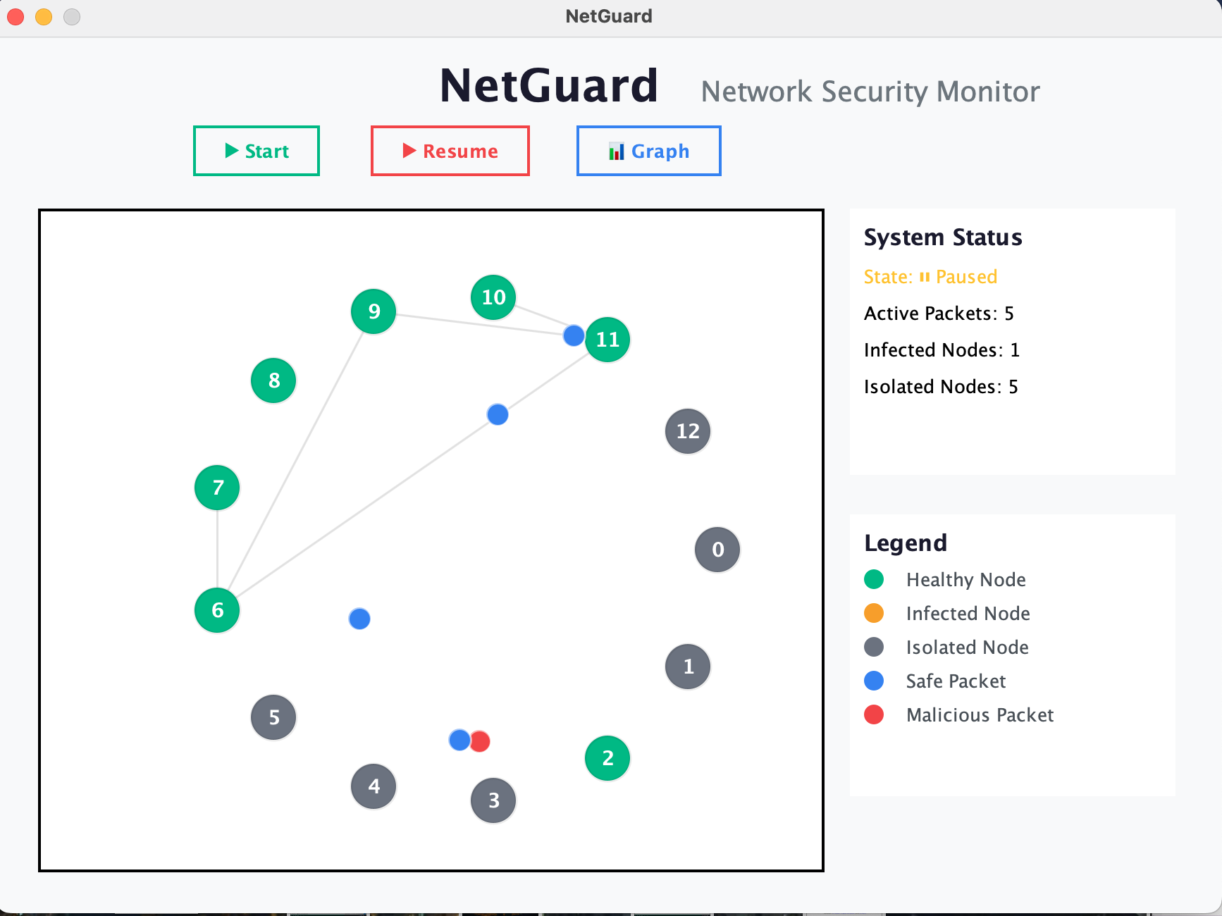
Results
(Screenshots)

Slide 13
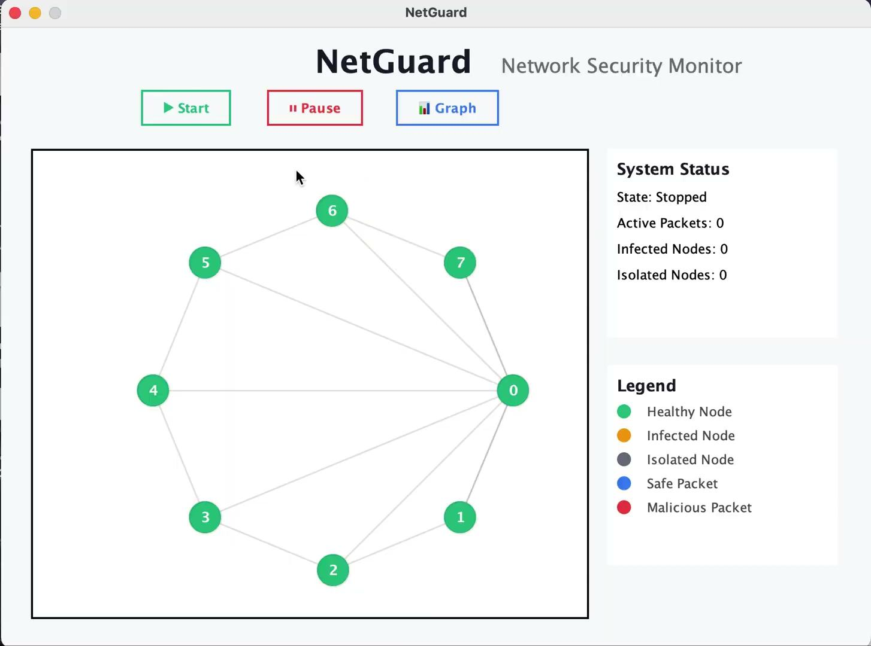
Results
(Recording)

Slide 14
Discussion (Reflection)
What we learned
How infections propagate through a graph
Importance of node isolation
Real-time simulation handling via Swing
Combining cybersecurity concepts with ADTs
GUI layout design in NetBeans
Challenges faced
Synchronizing infection timers with main simulation
Integrating MinHeap with Dijkstra's algorithm
Handling edge cases (isolated source/destination nodes)
Dynamic graph generation with variable node counts
Improvements made
NodeDistance wrapper for MinHeap compatibility
getHealthyNodes() to prevent unreachable packets
clearAllPackets() for proper graph regeneration
Comprehensive JavaDoc for code maintainability

Slide 15
Conclusions
Final Takeaways
NetGuard successfully simulates real-time network attack propagation
Demonstrates effectiveness of automated isolation strategies
Built entirely with custom ADTs (no external libraries)
Fully functional GUI with dynamic visualizations
All course requirements met (Bag, Queue, Heap, Graph)
Technical Achievements
Dijkstra's algorithm with custom MinHeap (O((V+E) log V))
Smooth 33 FPS animation with linear interpolation
3-stage infection cascade with timer synchronization
Dynamic graph generation (10-15 nodes)
Intelligent packet routing avoiding isolated nodes
Future Work
Weighted edges for realistic network latency
Firewall nodes with packet filtering
Scalability improvements for 100+ node networks
Add heatmap visualization
Add ML-based prediction of attacks

Slide 16
Job Assignments (Team Contributions)
Madhumitha N.
Implemented LinkedQueue FIFO system
Built GraphPanel rendering engine (paintComponent)
Created circle layout positioning algorithm
Developed packet animation with interpolation
Prepared presentation slides + documentation
Priyanka B.
Implemented MinHeap priority queue
Implemented Bag adjacency list
Implemented infection cascade timing in GraphPanel
Designed GUI in NetBeans (MainFrame) and Connected GUI components to backend logic
Added JavaDoc documentation, performed testing and fixed bugs
Srivardhan K.
Implemented Graph ADT with adjacency list (Ch. 29-30)
Developed Dijkstra's shortest path algorithm
Designed Node and Packet data models
Created network topology structure (ring + hub)

